Slide 1

e-Bug Junior Game

Slide 2
Junior Game
  Game Style
  Game Process
  Demo
  Game Mechanics and Learning Outcomes
  Feedback to date and evaluation plans

Slide 3
Game Style
  Game style encompasses two genres of game
    Platform game
      fast action
      very interactive
      can experiment and see results
      popular amongst age group
    Quiz game
      highlights purpose and key elements of levels
      reinforces learning
      assesses learning

Slide 4
Game Process
  Cover each of the LO's in one "round" of gameplay.
  A round consists of a pre and post question and answer session followed by a platform game elelement
  One 'round' features a different style of game because platform game wasn't suitable

Slide 5
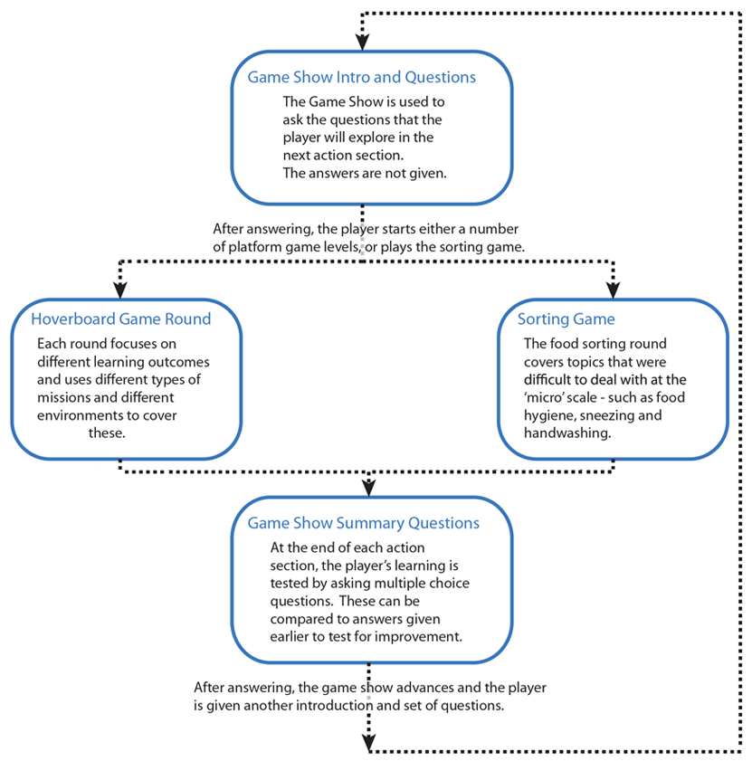
Game Process

Slide 6
Small Demo

Slide 7
Introduction to Microbes
  Introduction to Microbes
    Bacteria, viruses and fungi are three different types of microbe
    Microbes are found everywhere
    Microbes come in different shapes and sizes

Slide 8
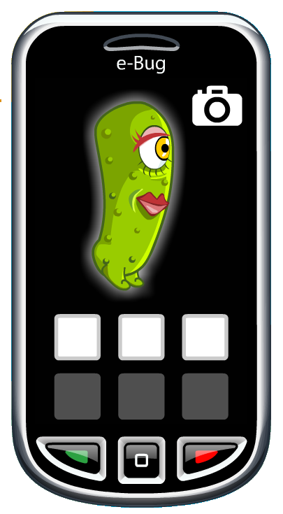
Introduction to Microbes
  Player photographs bugs one type at a time

Slide 9
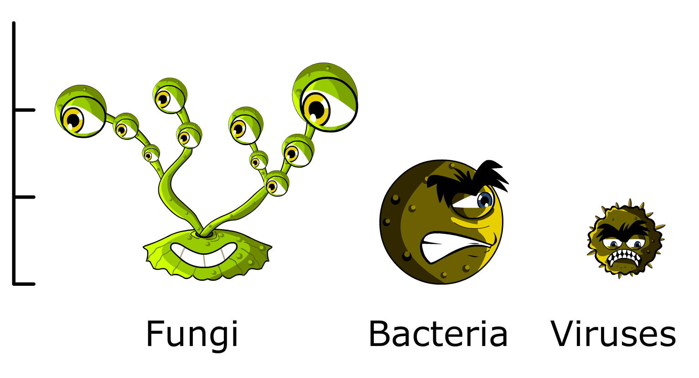
Introduction to Microbes
  Bugs are different sizes

Slide 10
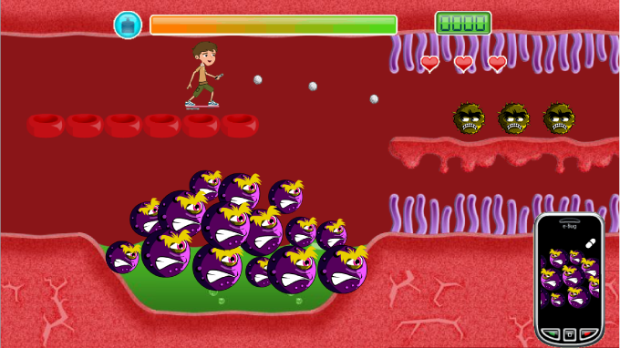
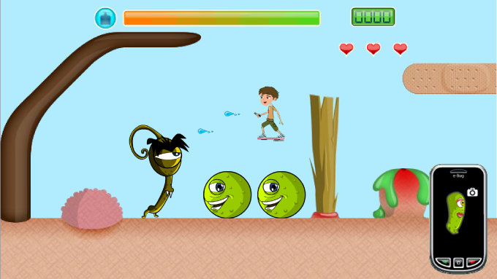
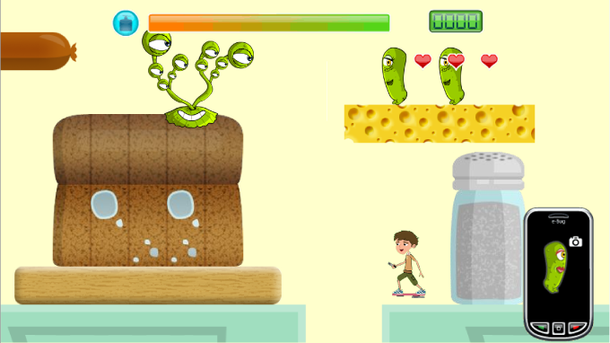
Introduction to Microbes
  Bugs are shown in different locations
Inside the body
On the skins surface
In the kitchen

Slide 11
Mechanics
  Good and Bad Microbes
    Good microbes can keep us healthy
    Bacteria can be put to good use
    Sometimes microbes make us ill

Slide 12
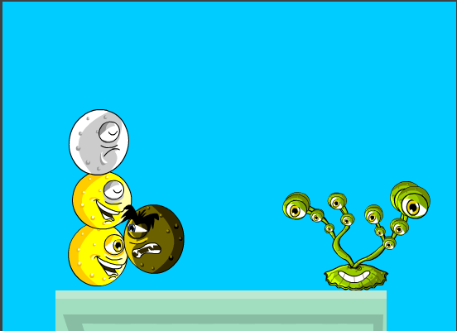
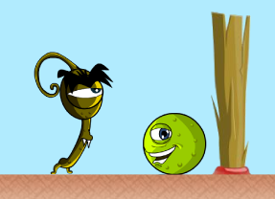
Good and Bad Microbes
  Good bugs hurt bad bugs and stop them entering body

Slide 13
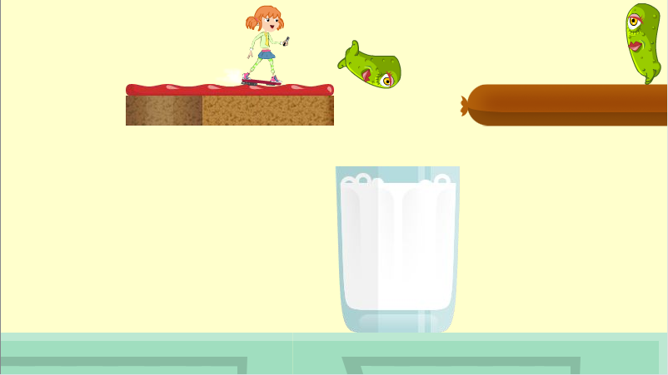
Good and Bad Microbes
  Player transports lactobacillus to make yogurt

Slide 14
Mechanics
  Hand, Respiratory and Food Hygiene
    Infection can be spread through unclean hands
    Hand washing can prevent the spread of infection
    Infection can be spread through sneezing and coughing
    Sneezing or coughing in your hand can still spread infection
    Microbes can be found on our food and can transfer to humans
    Cooking food properly can kill harmful microbes

Slide 15
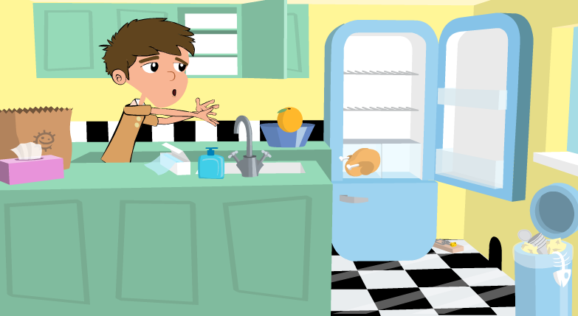
Hygiene
  The food sorting game is used to show hand, respiratory and respiratory hygiene.

Slide 16
Antibiotics and Vaccine Use
  Antibiotics and Vaccine Use
    Most common infections get better on their own through time, rest, liquid intake and healthy living
    If antibiotics are taken, it is important to finish the course
    Vaccines prevent a range of infections
    There are not vaccines for all infections

Slide 17
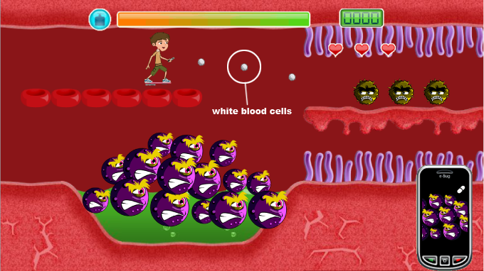
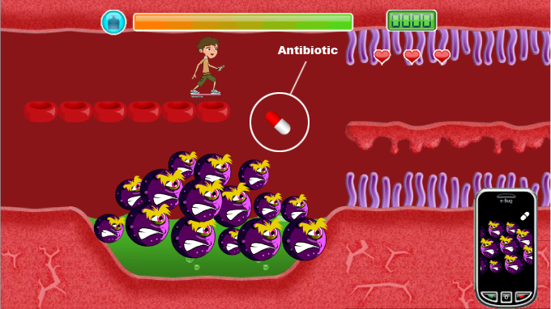
Antibiotics and Vaccine Use
  Player throws white blood cells
  Player delivers full course of antibiotics to infection

Slide 20


Thanks to Nancy and Sandy!

Slide 21
Evaluation Plans
  Formal evaluation to commence in September 2008, after school holidays.
  Quantitatively, two main methods to assess effectiveness of the game.
    The game show element asks pre-and post questions about the outcomes covered in the action elements. We collect this invisibly over the internet to see if the player has learned from the play experience.
    Physical questionnaires in schools pre and post to validate quality of internet data.
  Qualitatively, will conduct focus groups and ask school pupils and teachers to answer open ended questions on a questionnaire.

Slide 22
Evaluation Continued
  Alongside the main game evaluation, we will run a series of smaller scale evaluations of updates to the design.
    We will have an idea soon after the game goes live whether or not a particular mechanic appears to be teaching the LO or not.
    We will change the gameplay of less effective mechanics

